Slide 1




Supply Chain
Data
Analysis & Visualization
From Production to Delivery
Data analysis turns supply chains into intelligent, strategic systems.

Slide 2

Rawnaa Mustafa Hussien
Hana Ahmed Mohamed
Rowaa Ashraf Salah
Nancy Nagy Farah
Yasmin Mokhtar Esmail

Slide 3


Outline
1
Objectives of the Project
2
Dataset overview
Data Periods
Dataset columns
3
Data Preparation Summary
Data Cleaning
Data Modeling
4
Key Business Questions
5
Key metrics & KPIs
6
Report results

Slide 4

Objectives of the Project
Optimize Operational Efficiency
Streamline the manufacturing, inspection, and shipping processes to reduce lead times.
Enhance Product Quality and Reliability
Monitor defect rates and supplier performance to minimize product failures and maintain consistent quality standards.

Slide 5
Objectives of the Project
Maximize Sales and Profitability
Analyze product categories, pricing, and customer demographics to focus on high-demand segments.
Deliver Business Insights
Provide insights that support strategic decisions on pricing, transportation, and customer targeting.

Slide 6

Dataset Overview - Data Periods
The dataset contains information on 100 products, including stock levels, revenue, number of products sold, and lead times
It contains 24 columns and it’s structured for a defined time period to reflect overall supply chain performance.

Slide 7

Dataset Overview - Data Columns
Product type.
Revenue Generated.
SKU.
Number of Products sold.
Price.
Availability.

Slide 8
Dataset Overview - Data Columns
Order quantities.
Customer demographics.
Stock levels.
Shipping times.
order time.
Shipping carriers.

Slide 9
Dataset Overview - Data Columns
Shipping cost.
Lead time.
Supplier name.
Production volumes.
Location.
Manufacturing lead time.

Slide 10
Dataset Overview - Data Columns
Manufacturing cost.
Transportation modes.
Inspection results.
Routes.
Defect rates.
Costs.

Slide 11

Supplier, Manufacturing & Quality
Business Questions -
Which suppliers have the highest failed inspections?
Which SKUs recorded the highest defect rates on average?
What is the relation between manufacturing cost and selling price?
What is the average defect rate per product type?

Slide 12
Inventory & Supply Chain Operations
Business Questions -
What is the average order time, manufacturing time, and shipping time?
Which product type (skincare, haircare, cosmetics) shows the highest inventory turnover rate and availability?

Slide 13
Sales, Revenue & Profitability
Business Questions -
What is the total revenue and how does it distribute across product categories?
How close is the business to achieving its target profit goal?
Which product types drive the most sales volume?

Slide 14
Business Questions -
Transportation Efficiency
Which transportation mode (road, rail, air, sea) is most cost-effective?
Which shipping carriers show the best performance in terms of time
What are the average shipping times and costs across different modes and routes?

Slide 15
Business Questions -
Customer & Regional Insights
Which customer demographic contributes the most to total revenue?
Which locations generate the highest revenue?
Which demographic purchases the highest number of products?
Which product types are the most profitable overall, and how does profitability vary by demographic group?

Slide 16

Key Metrics & KPIs
Inventory Turnover: This measures how efficiently inventory is being sold and replaced.
Overall Availability: This measures the percentage of available stock relative to total stock levels.

Slide 17
Key Metrics & KPIs
Productivity: This KPI evaluates how much output (production volume) is achieved per unit of manufacturing cost.
% Failed, Passed and Pending products according to inspection results.

Slide 18
Key Metrics & KPIs
Averages: Defect Rate, Manufacturing Cost, Manufacturing Lead Time, Production Volume, Shipping Time, Supplier Lead Time, Transportation Cost.
Totals: Total Revenue, Total Quantities, Total Products sold, Total Products produced, Total Costs.

Slide 19




Key Insights
Supplier 4 shows the highest inspection rate % with 66.7% also with no passed inspections which can lead to increased quality costs and delays.
Manufacturing cost and price shows negative relationship which is unexpected in most cases.
Top 10 defective SKUs are: SKU1, SKU2, SKU3, SKU42, SKU50, SKU55, SKU61, SKU65, SKU73 and SKU84

Slide 20
Key Insights
Average order time, manufacturing time and shipping time is 15.96, 14.77 and 5.75.
Total profit is 519.40k when the target was 600k.
Skincare product type has the highest turnover rate and overall availability among all the other products.
Haircare recorded the highest average defect rate with 2.5, skincare with 2.3 and cosmetics with 1.9

Slide 21
Key Insights
Total revenue is 577.60k .
Skincare records the highest revenue generated, products sold and quantities ordered.
Average shipping time for Sea, Rail, Road and Air is 7.12, 6.57, 5.12 and 4.72.
Average costs for Sea, Rail, Road and Air is 417, 541, 561 and 553.
Sea transportation mode records the lowest costs among the other modes.
Carrier B records the lowest average shipping time.

Slide 22
Key Insights
Unknown contributes to the most revenue and total products sold then female.
Mumbai generated the highest revenue among other locations with 130.7k.
Skincare product type is the most profitable.
Female generated more profit in skincare and cosmetics while male generated more in haircare.

Slide 23
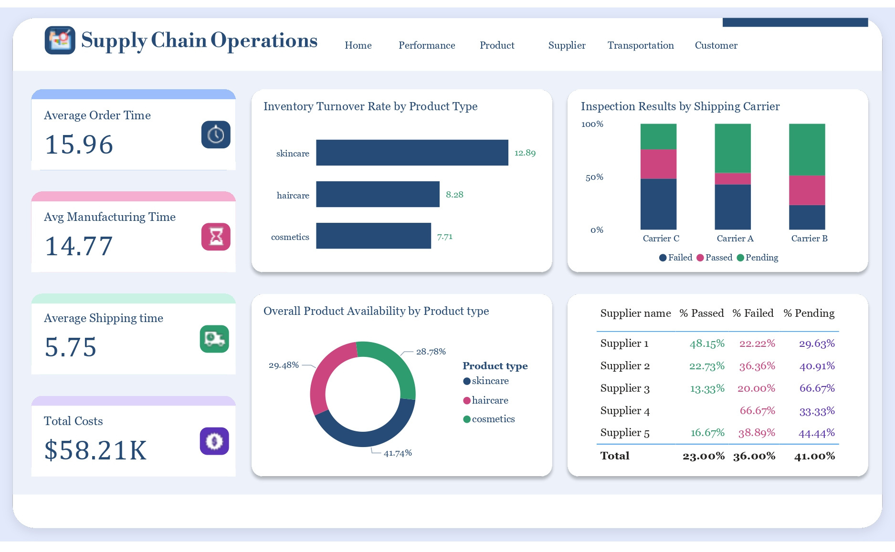

Slide 24
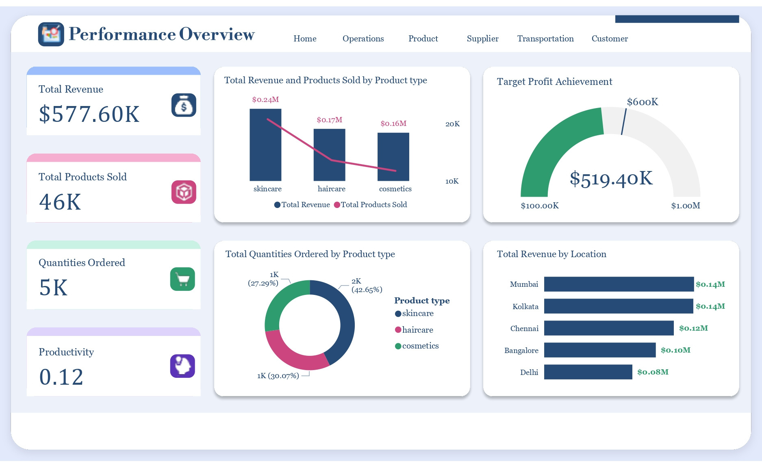

Slide 25
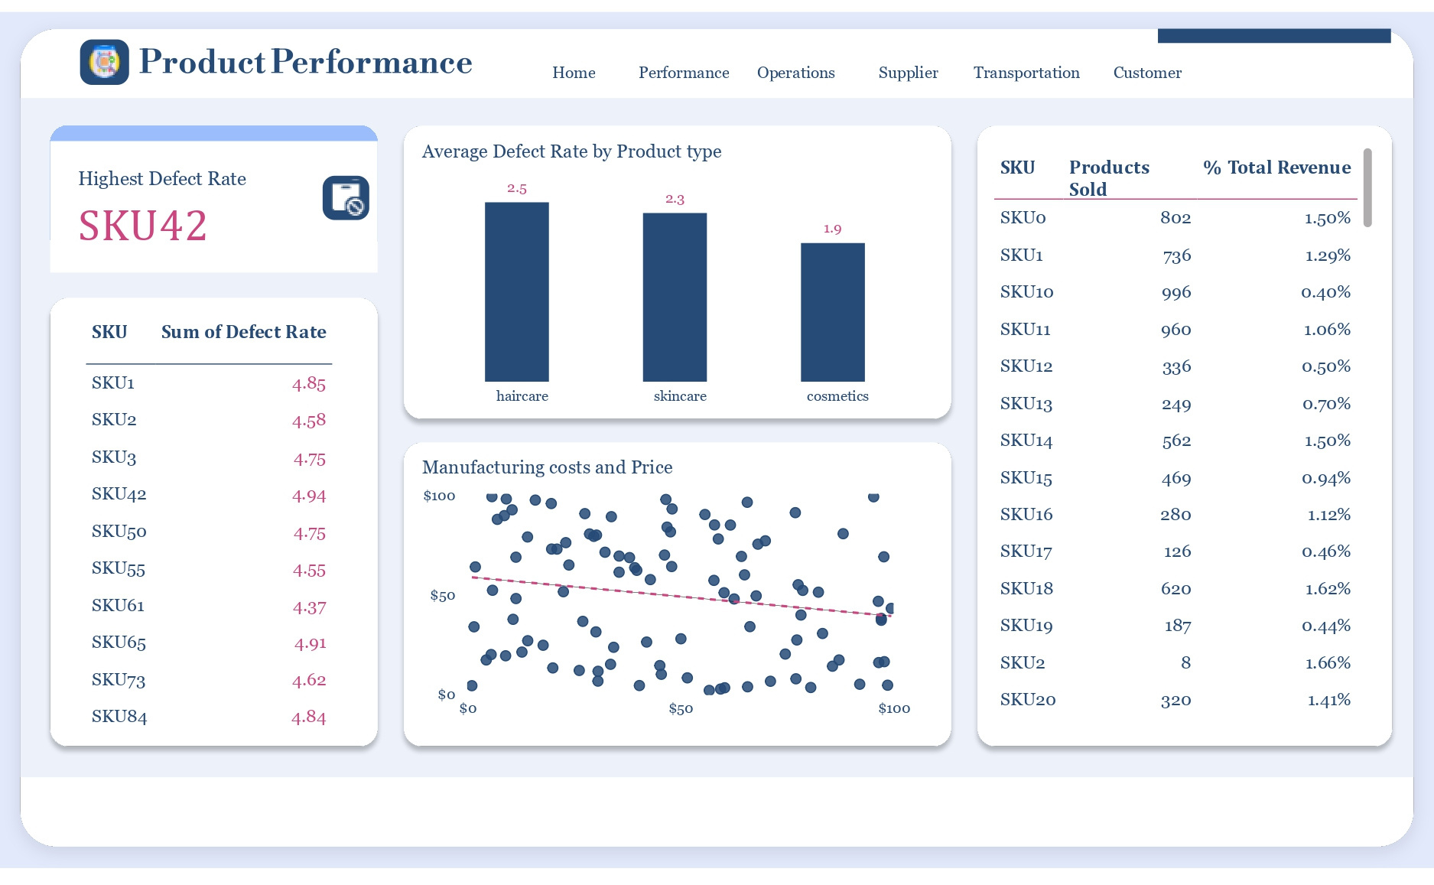

Slide 26
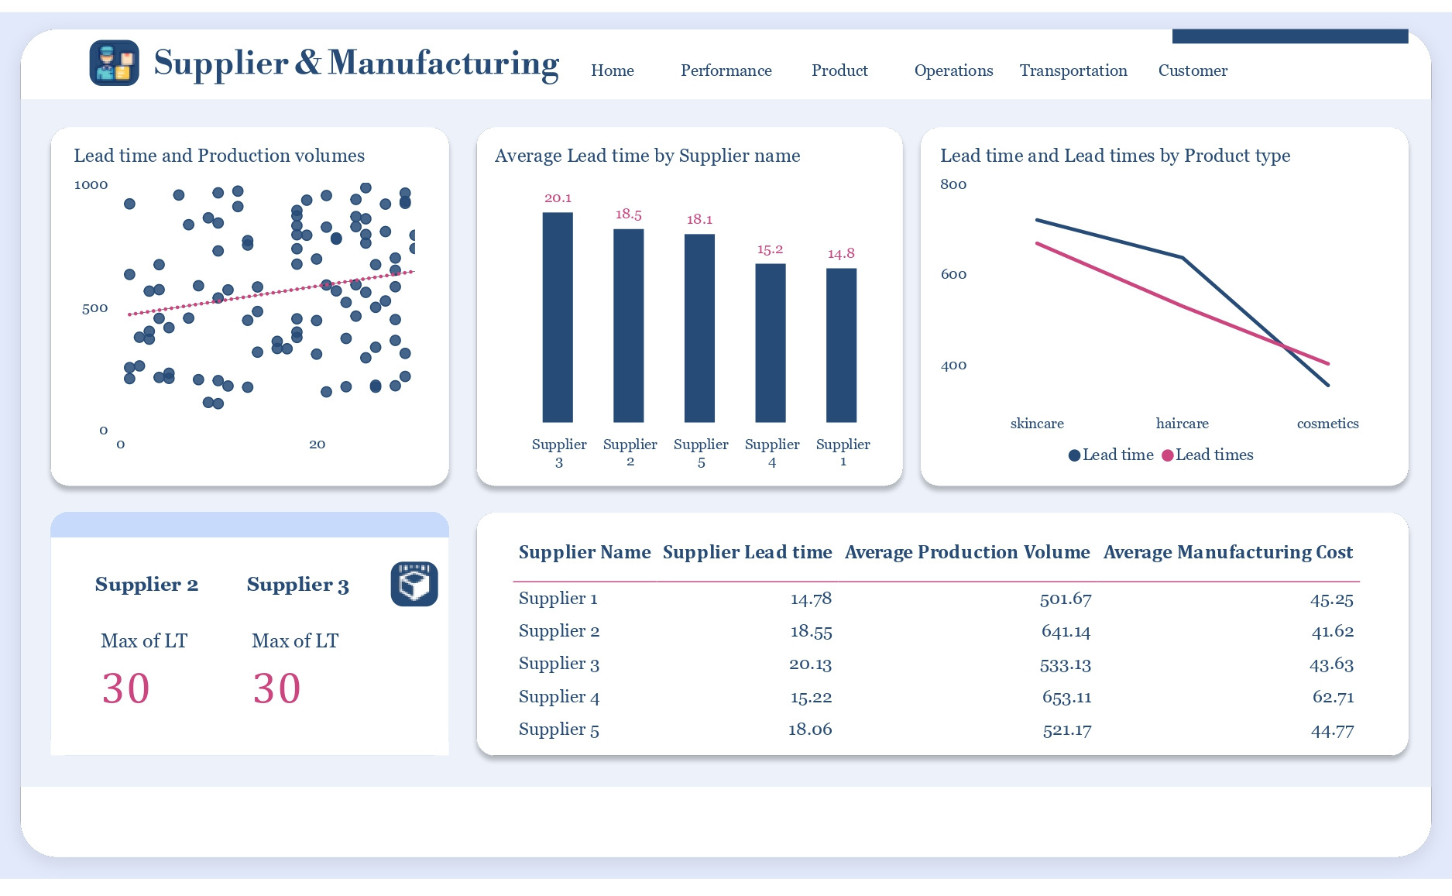

Slide 27
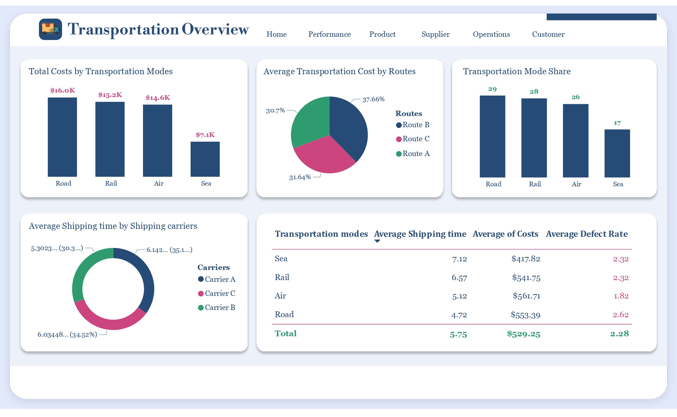

Slide 28
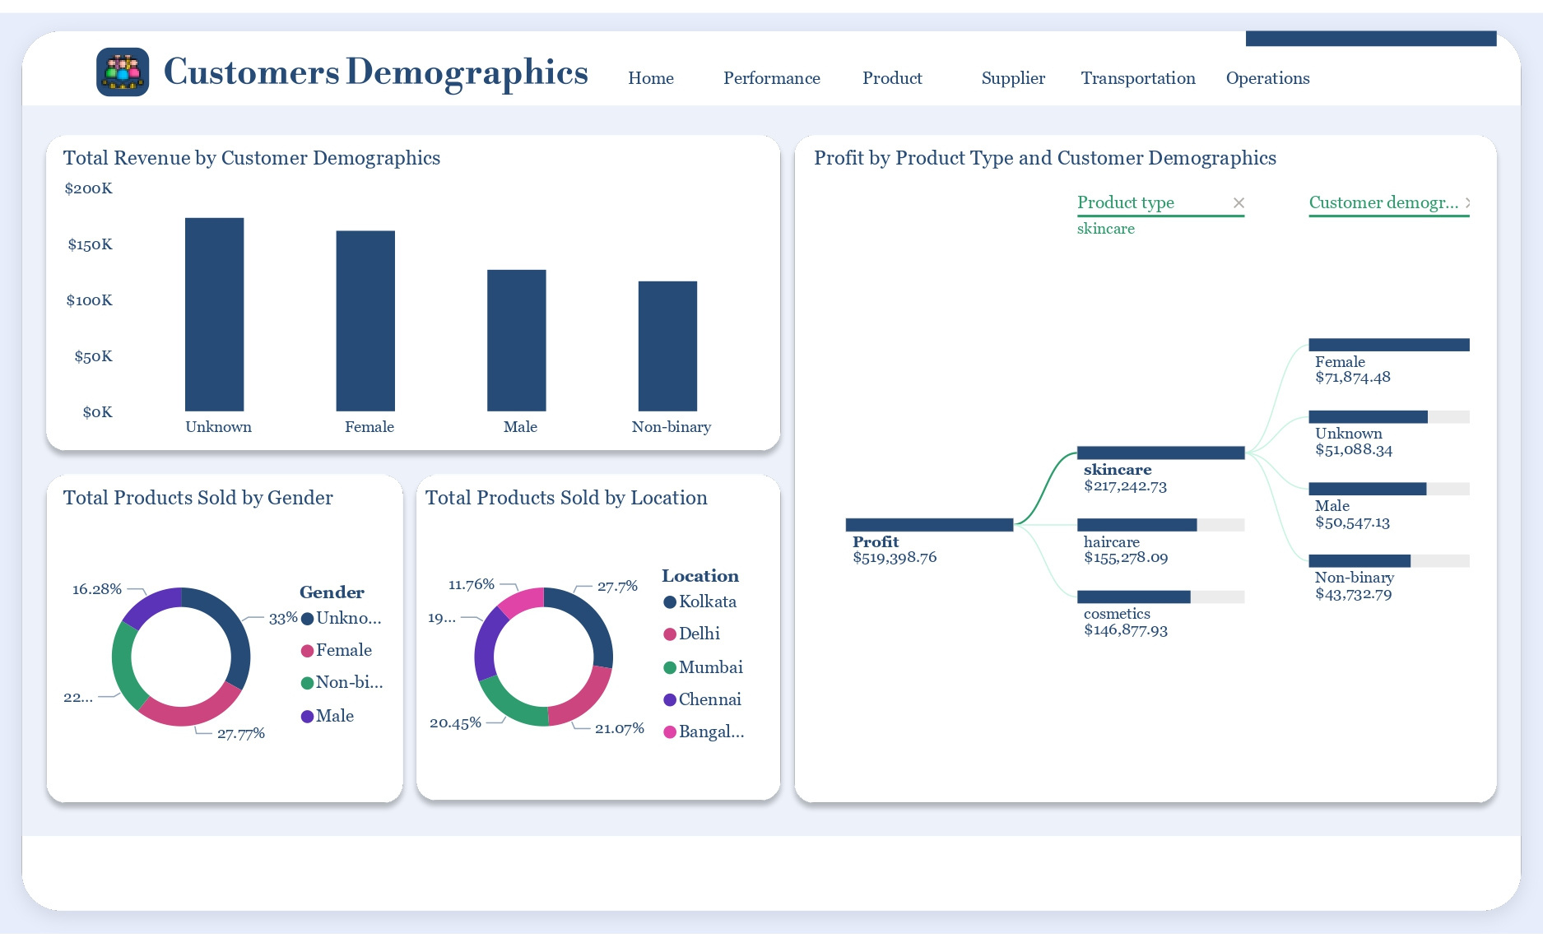

Slide 29
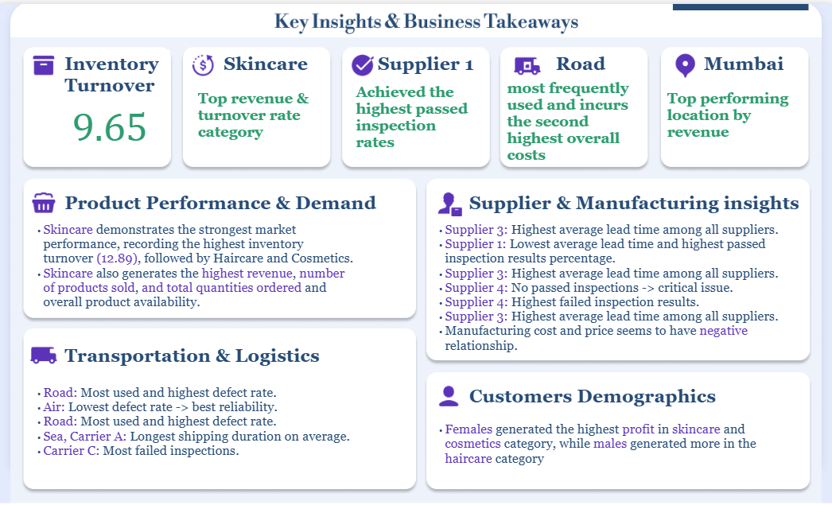

Slide 30

Thank you!!!

